Slide 1
Build It
You will look at an image for 3 seconds.
You will have 60 seconds to build it.
(That’s actually quite a bit of time!)

Slide 2
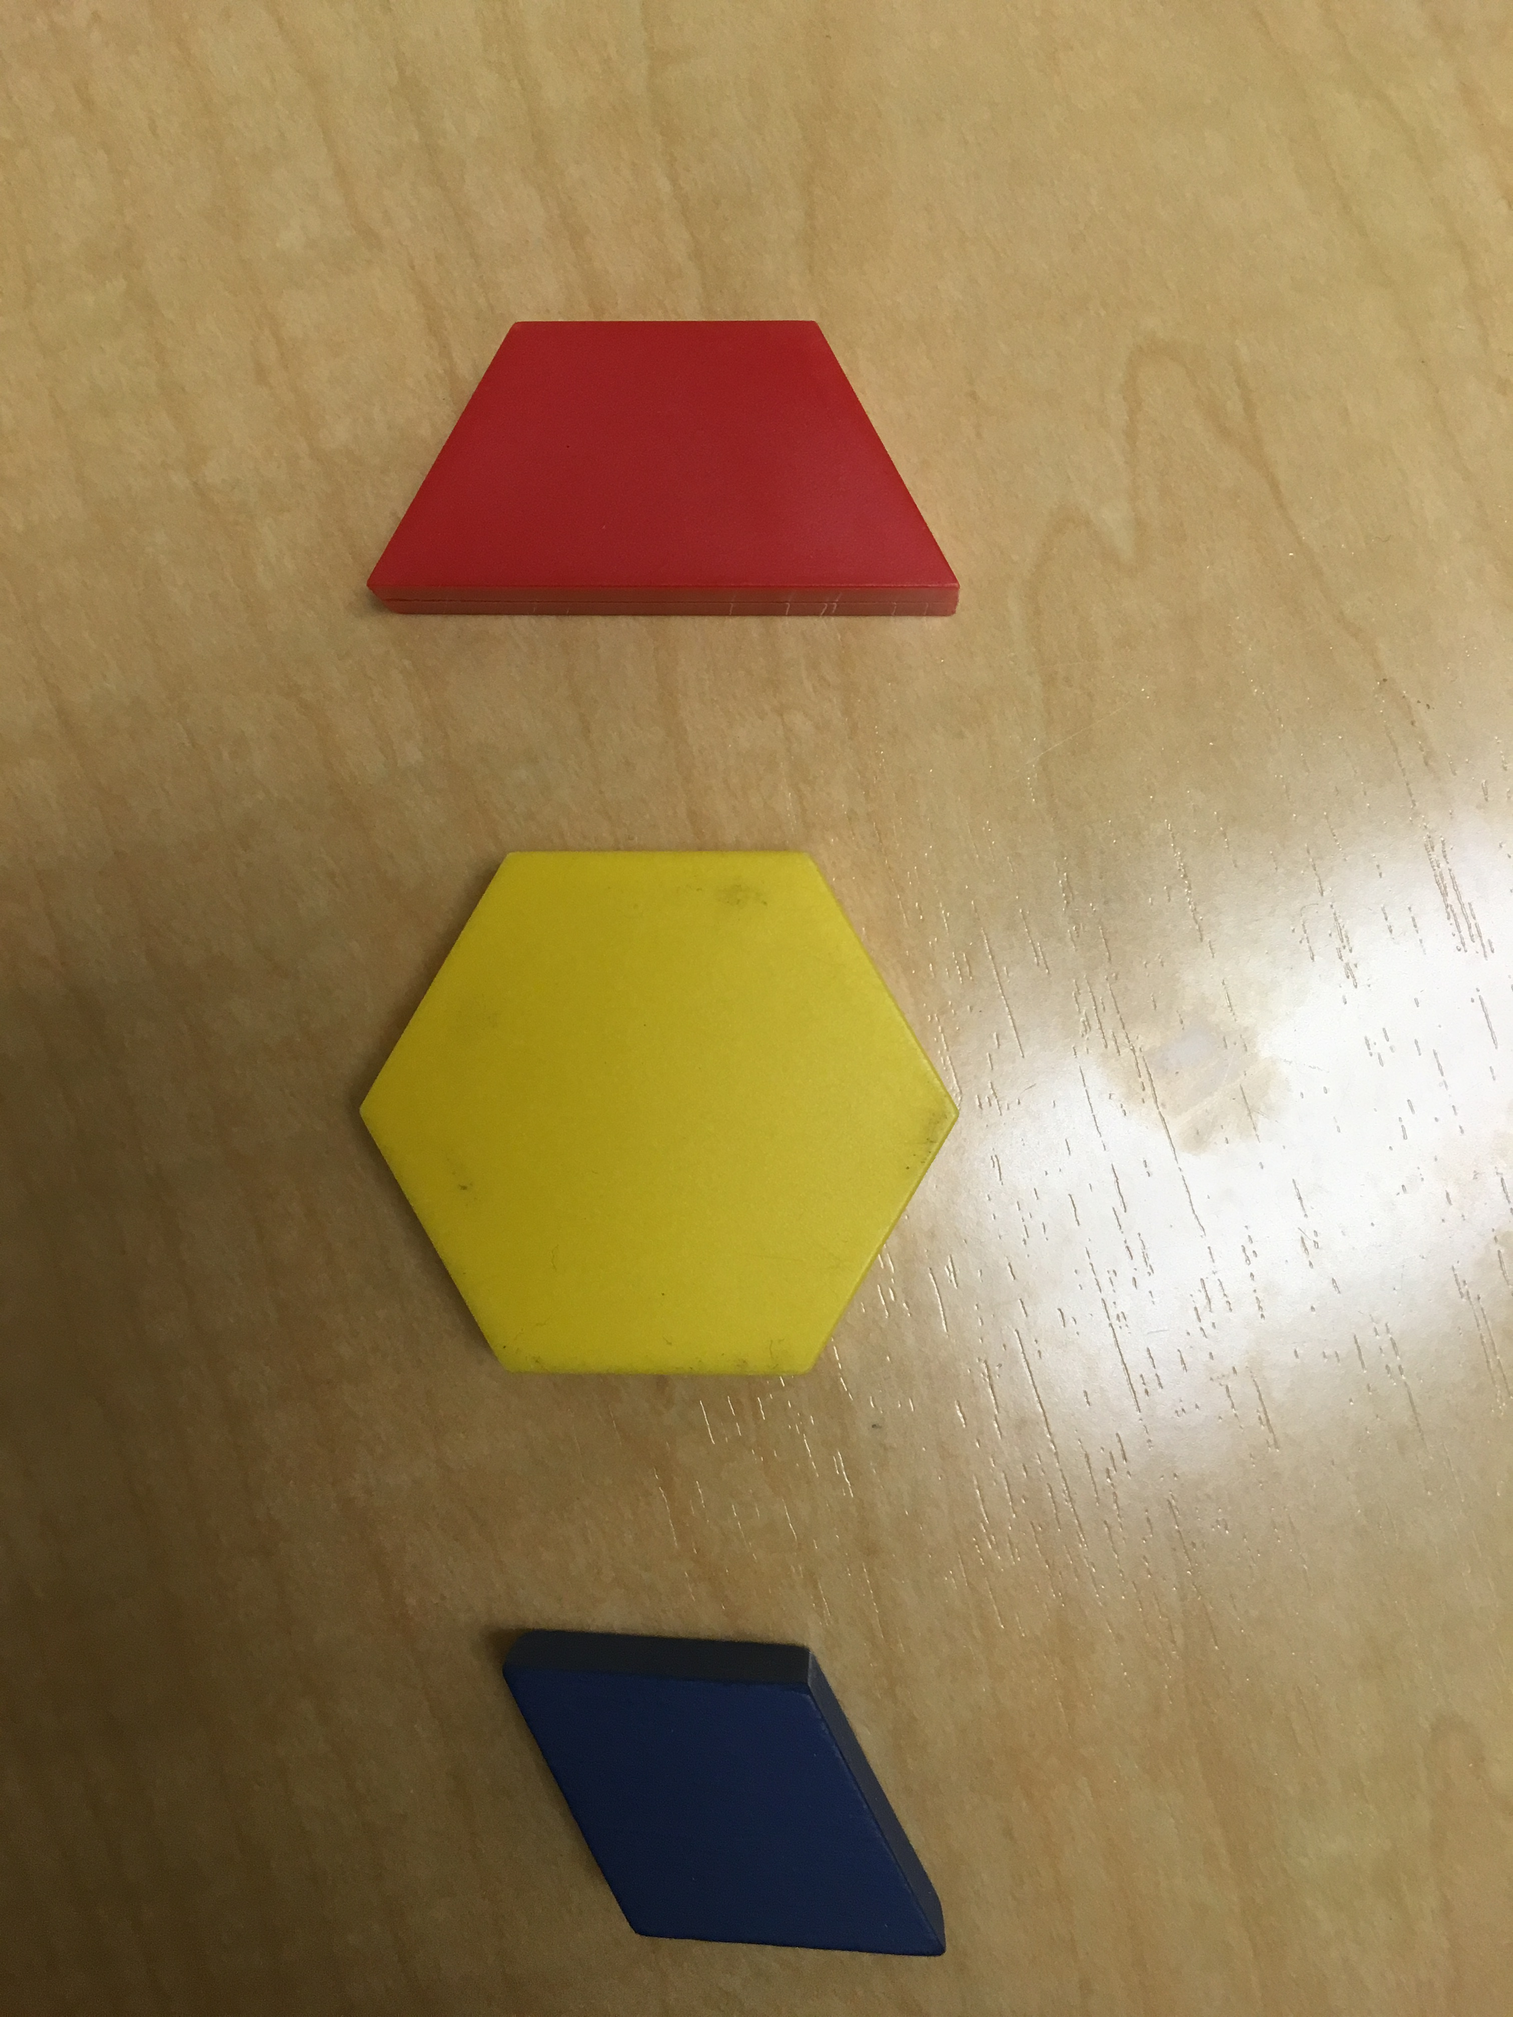
You will need
2 Trapezoids
2 Hexagons
3 Rhombuses

Slide 3
READY…You have 3 seconds to look

Slide 4
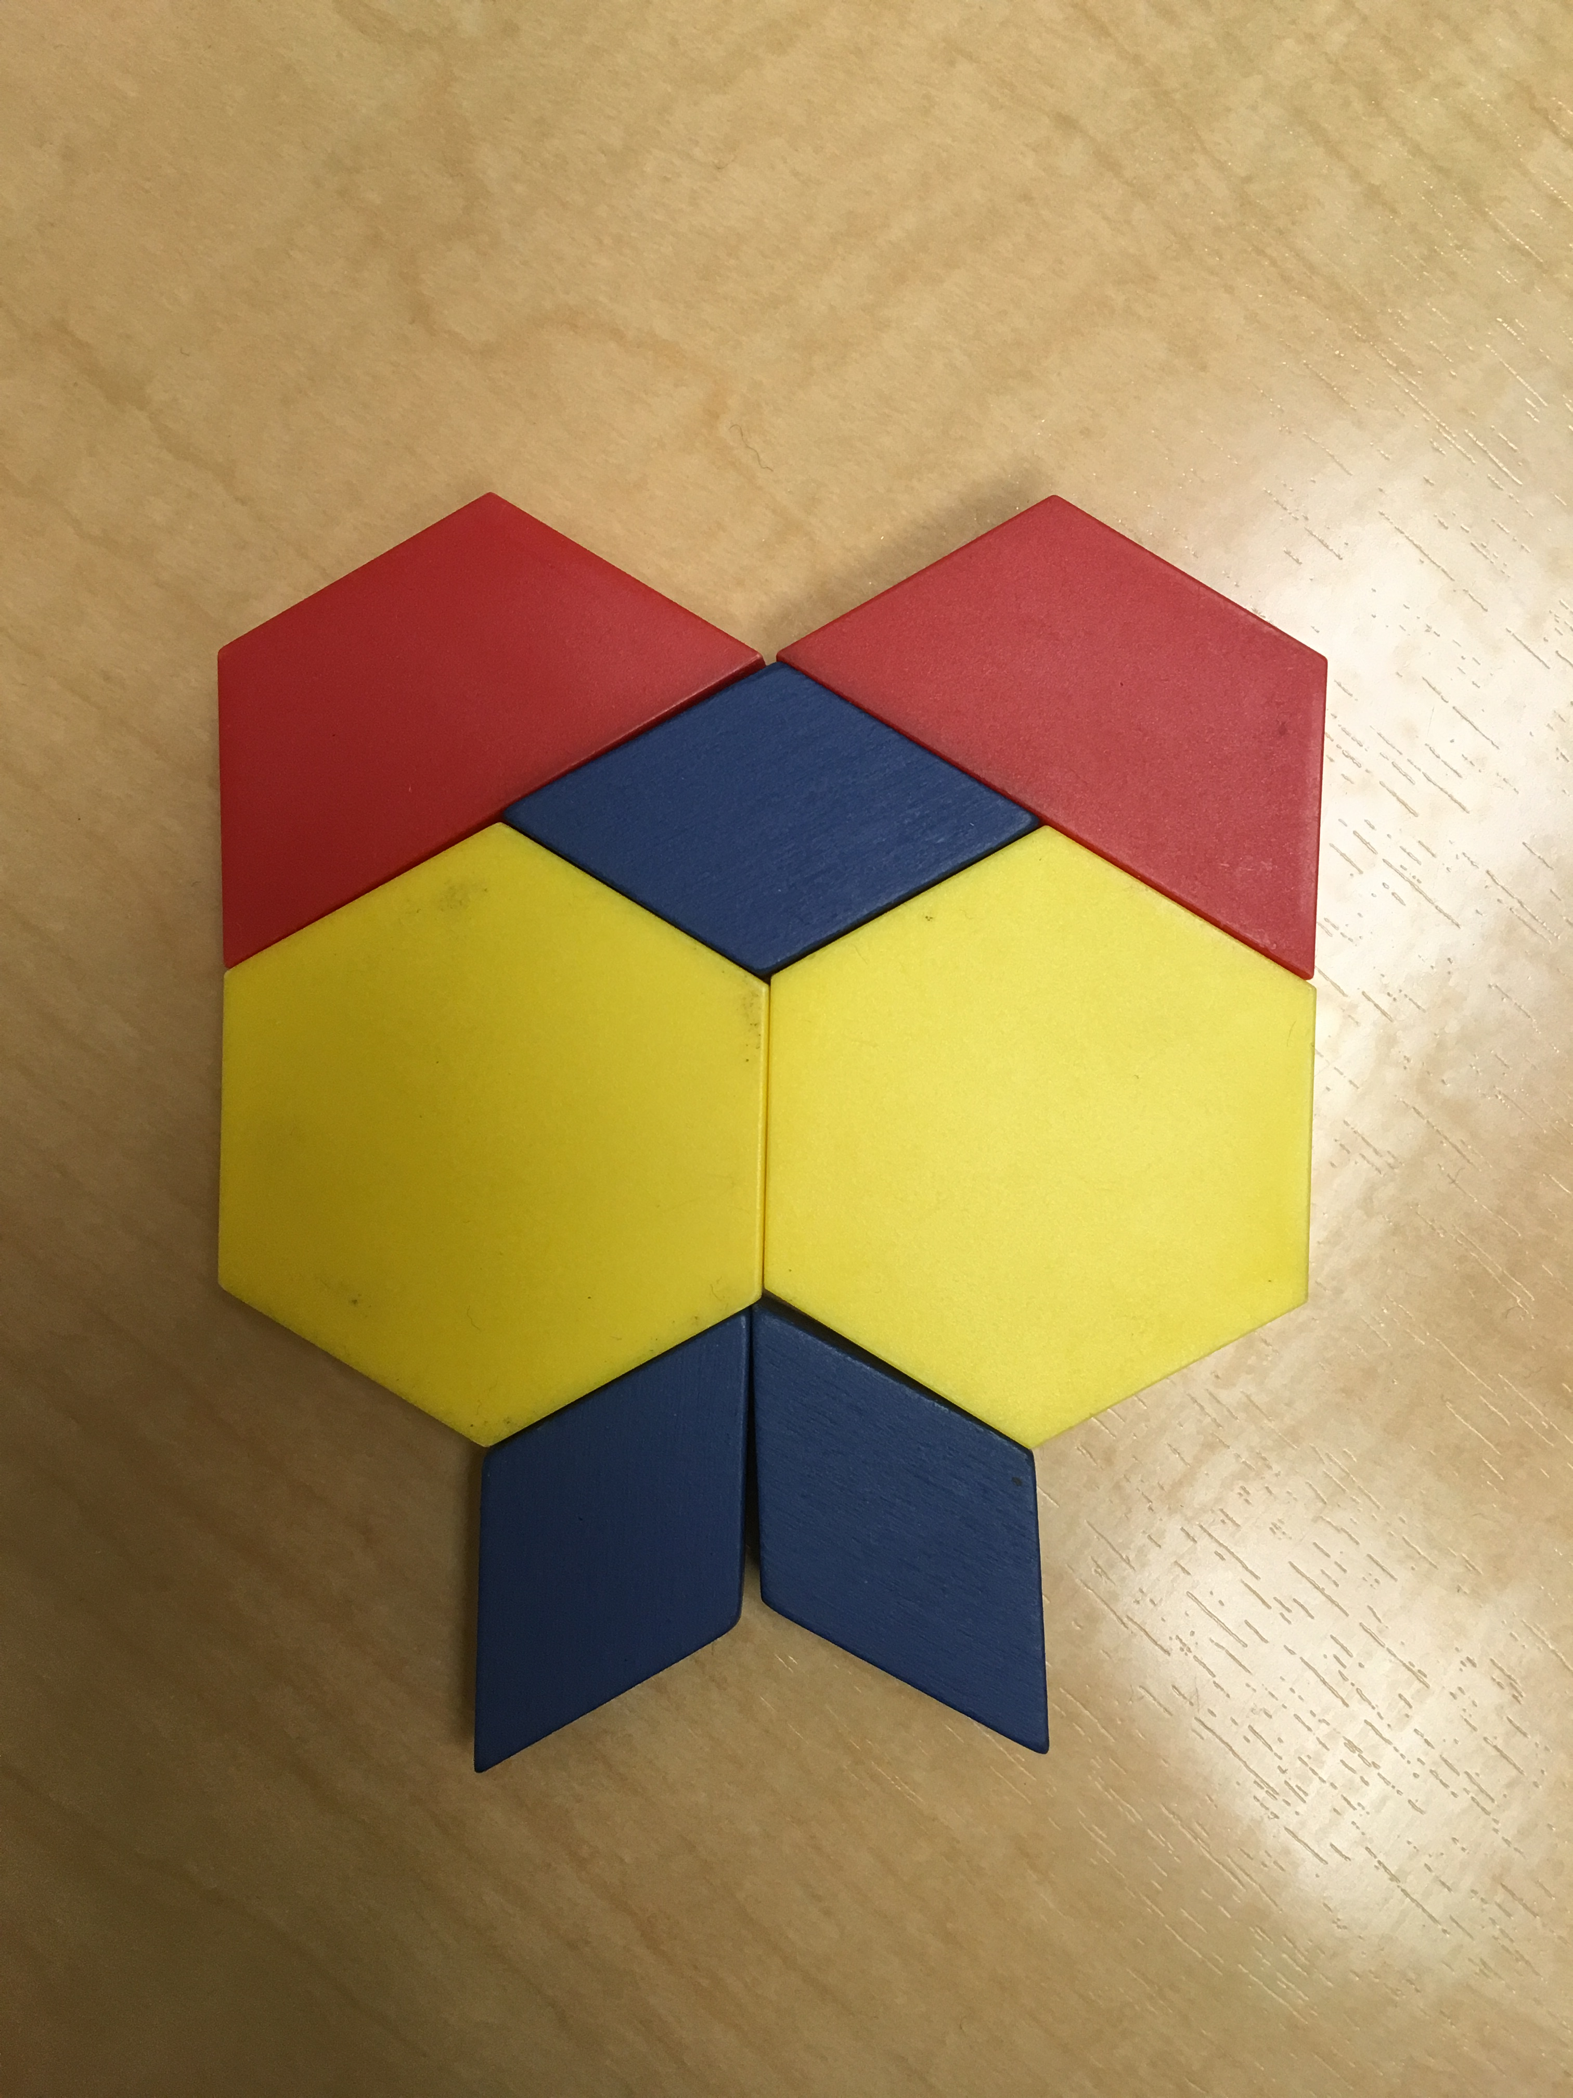

Slide 5
Build it!

Slide 7
Build it!
Did you make any changes?

Slide 8
Can you build it with different shapes?
How many different ways?

Slide 9
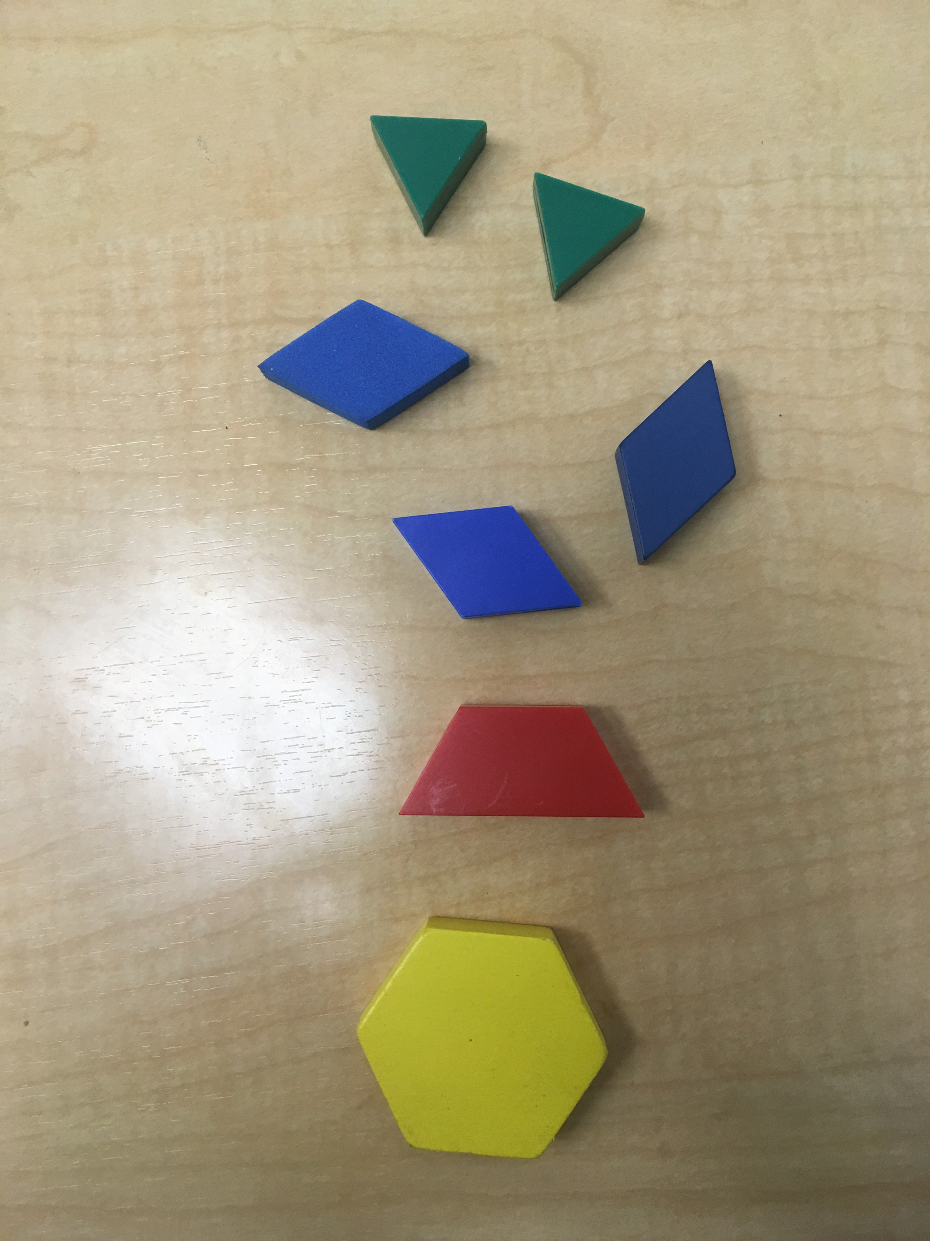
You will need:

Slide 10
Ready…Set…Look!

Slide 11
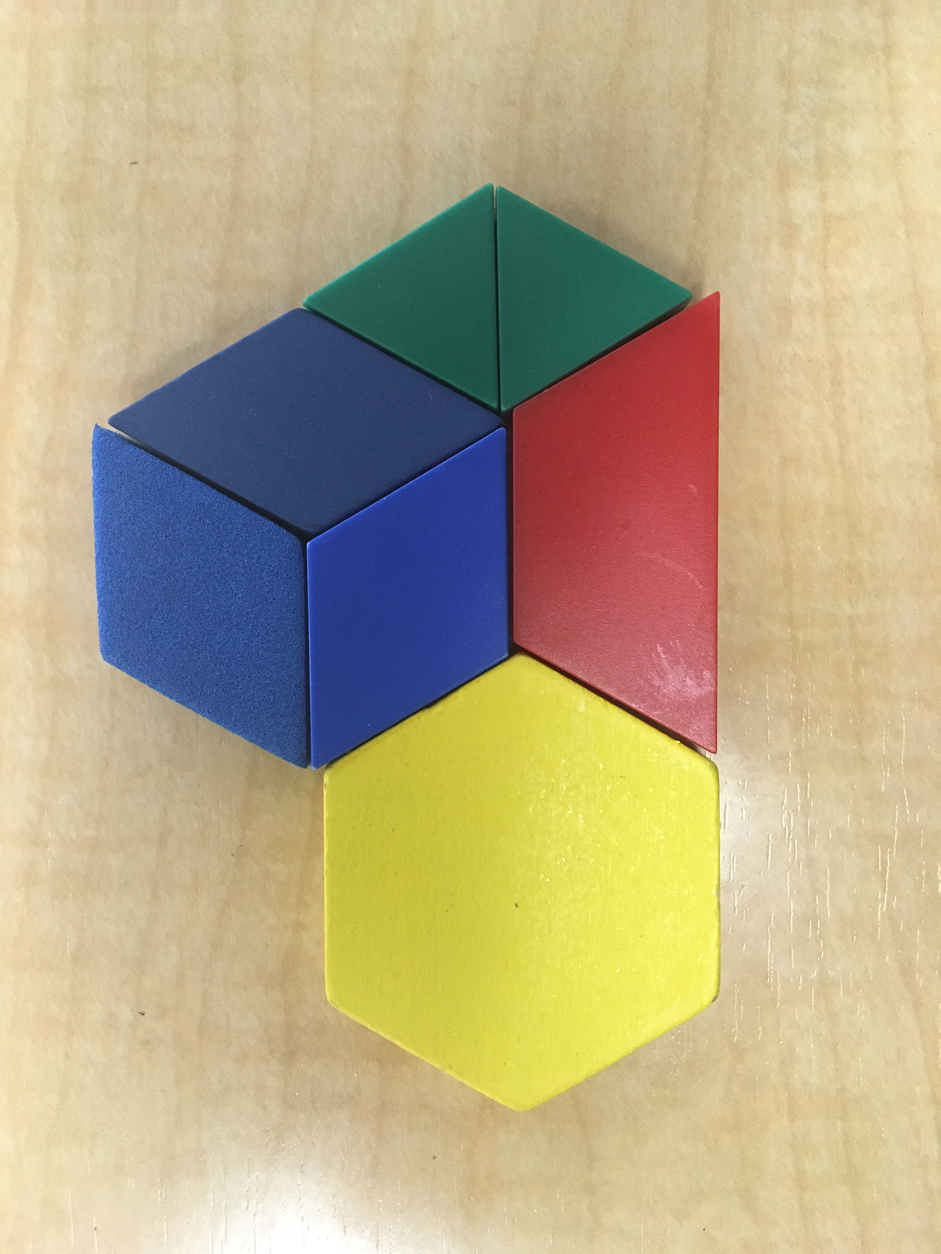

Slide 12
Build it!

Slide 14
Build it!

Slide 15
Can you build the same figure suing different shapes?
How many different ways can you build it?

Slide 16
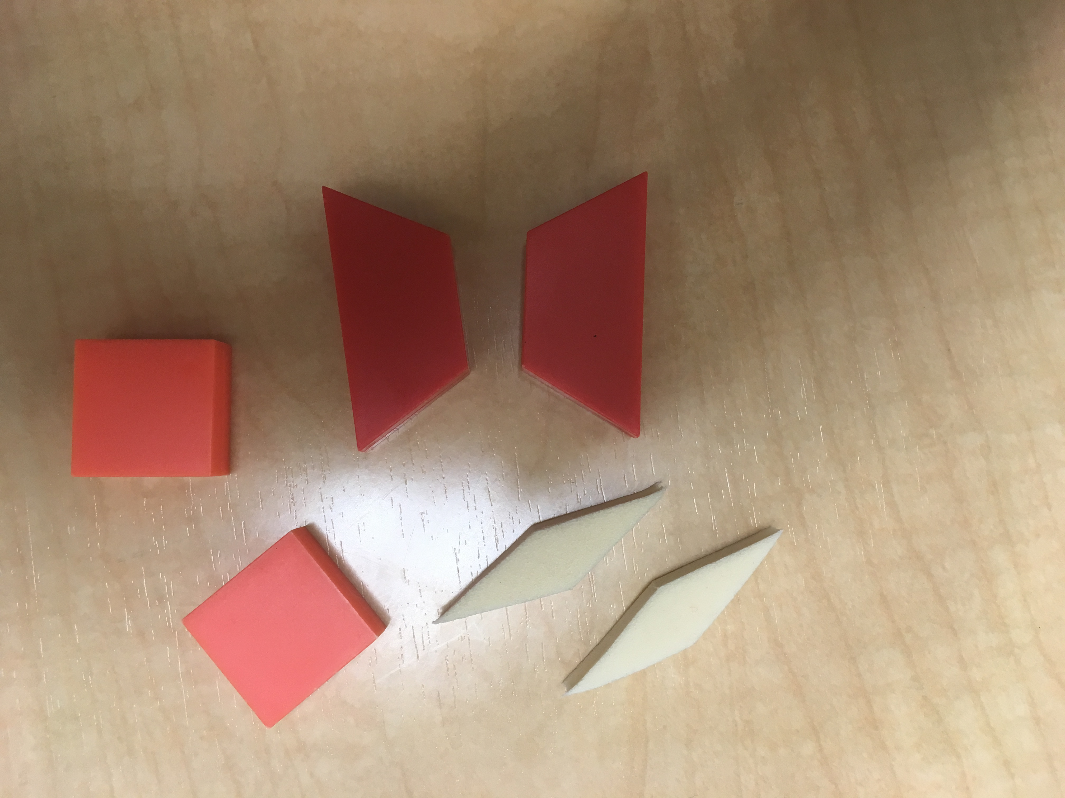
You need:

Slide 17
Ready…Set…Look!

Slide 18
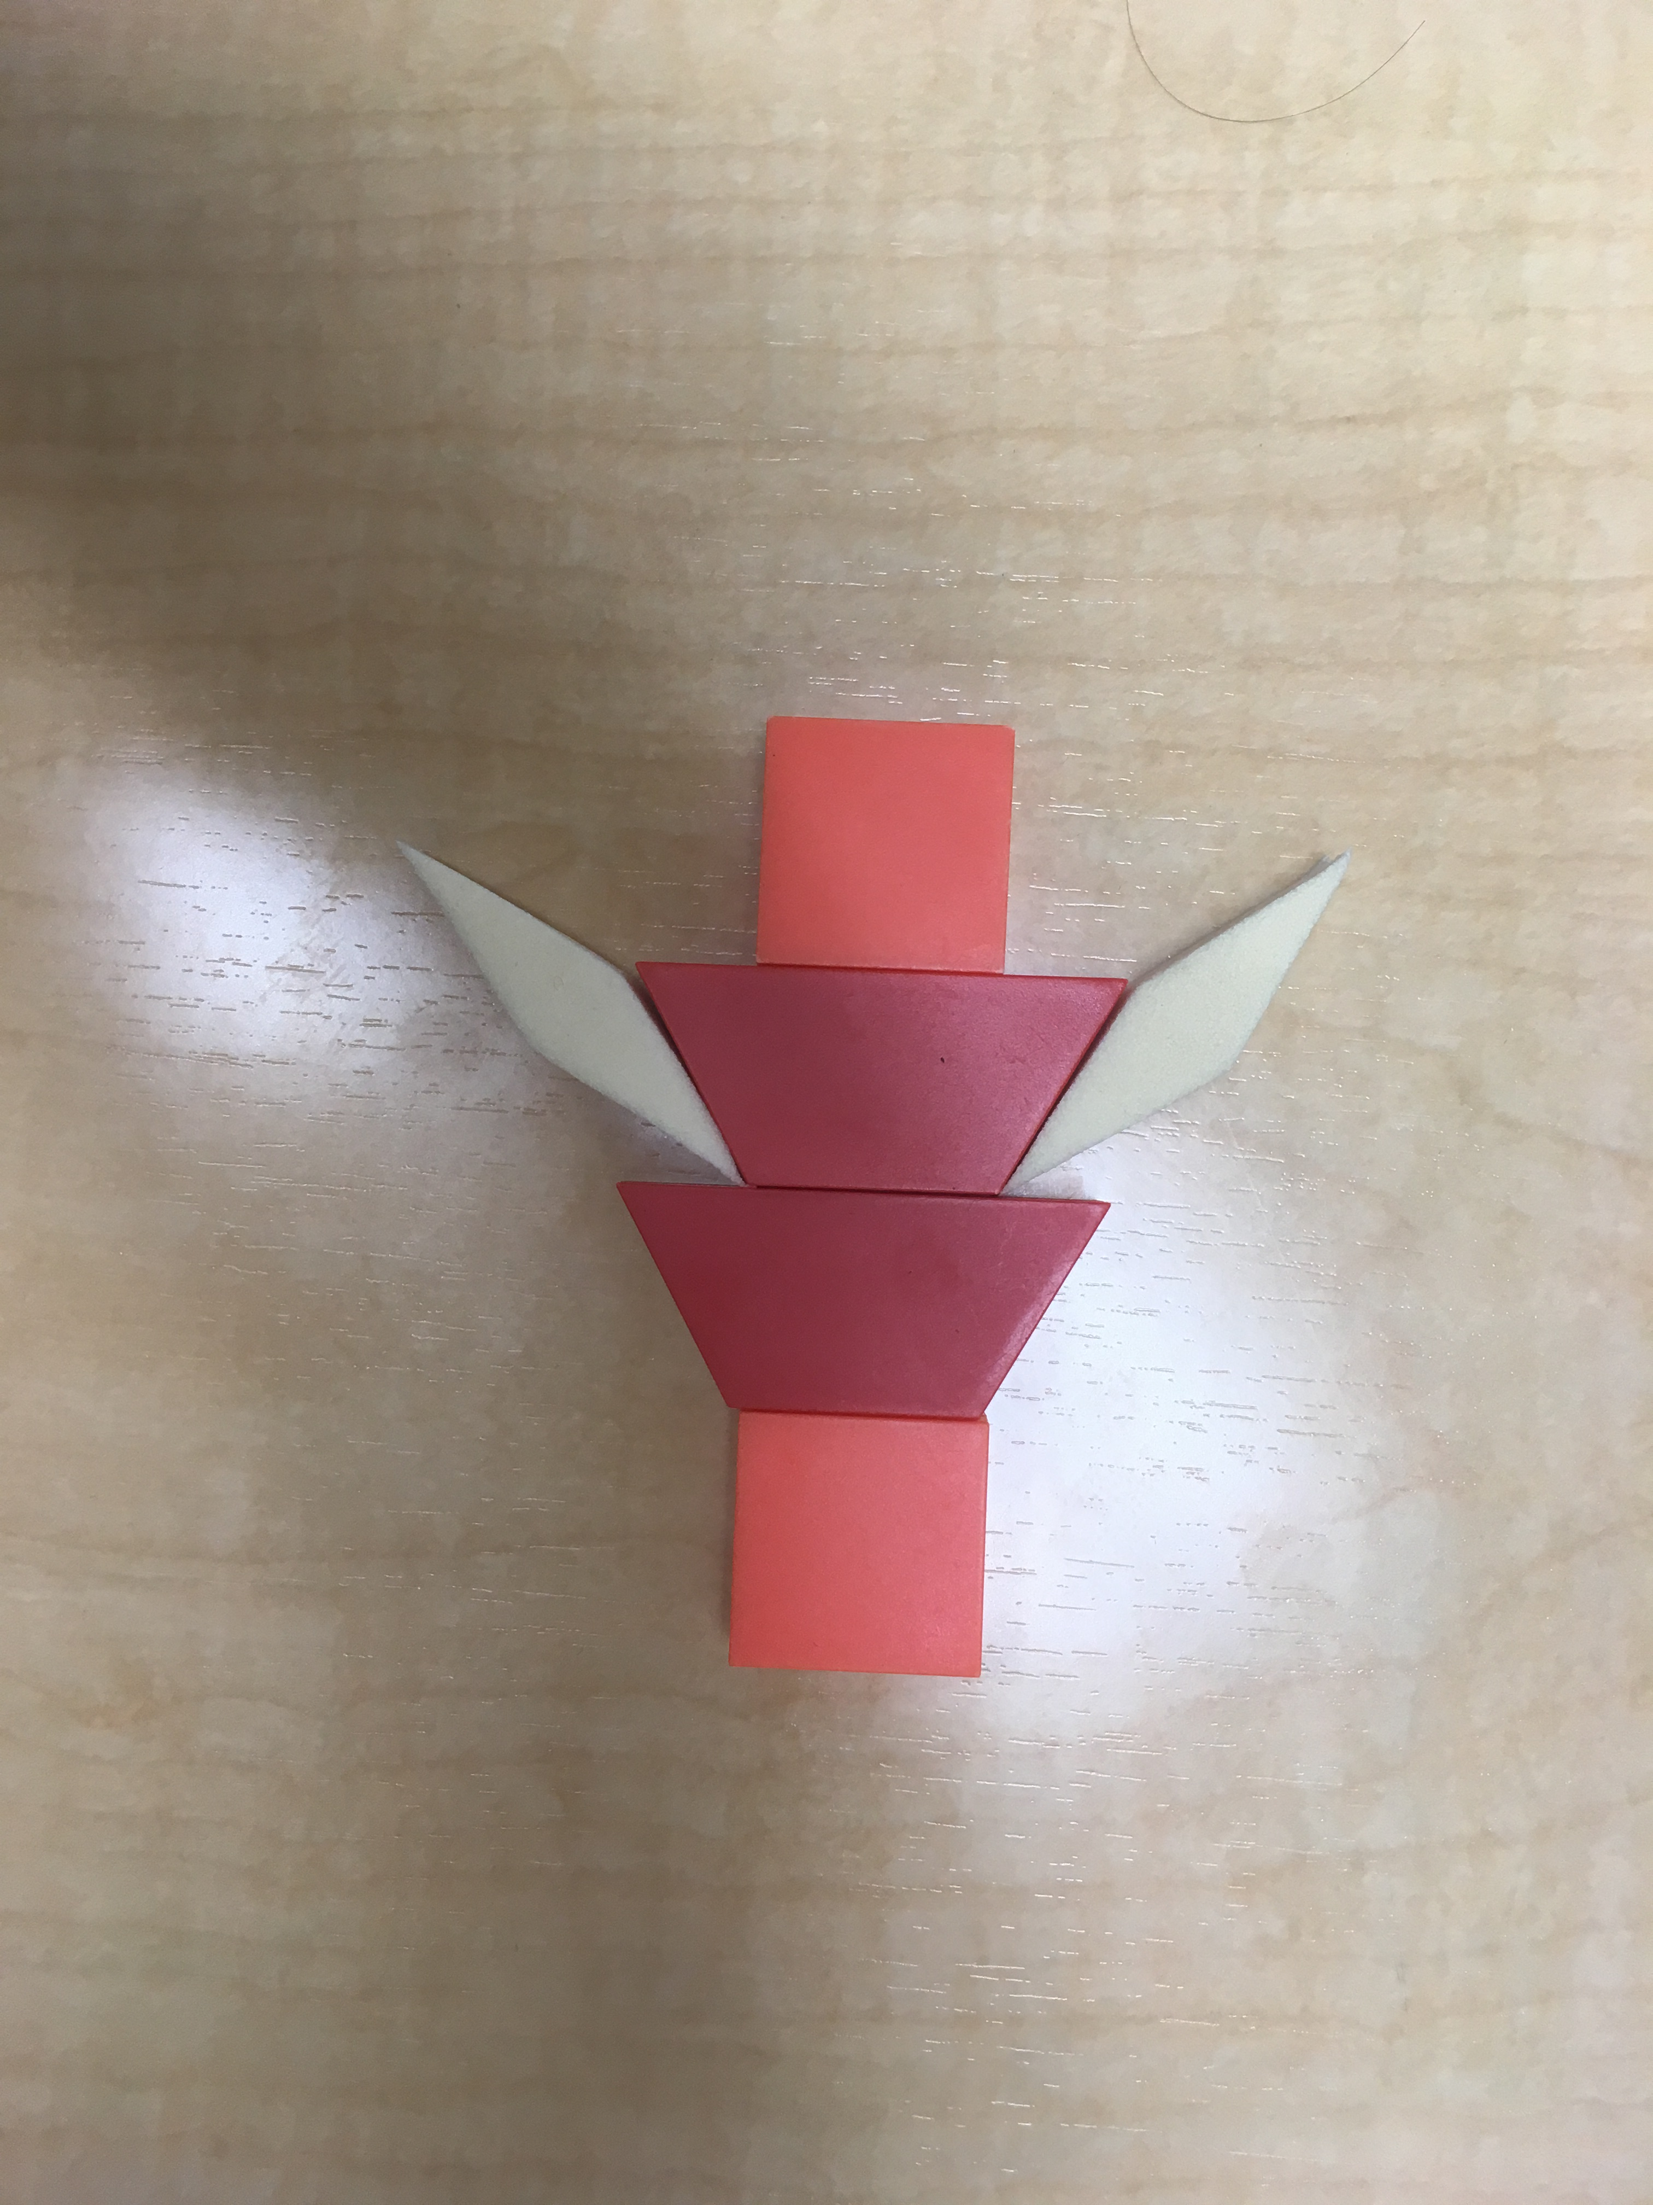

Slide 19
Build it!

Slide 21
Build it!

Slide 22
Can you build the same figure with different shapes?
How many different ways can you build it?

Slide 23
You will need:
1 hexagon 2 trapezoids 4 rhombuses

Slide 24
Ready…Set…Look!

Slide 25
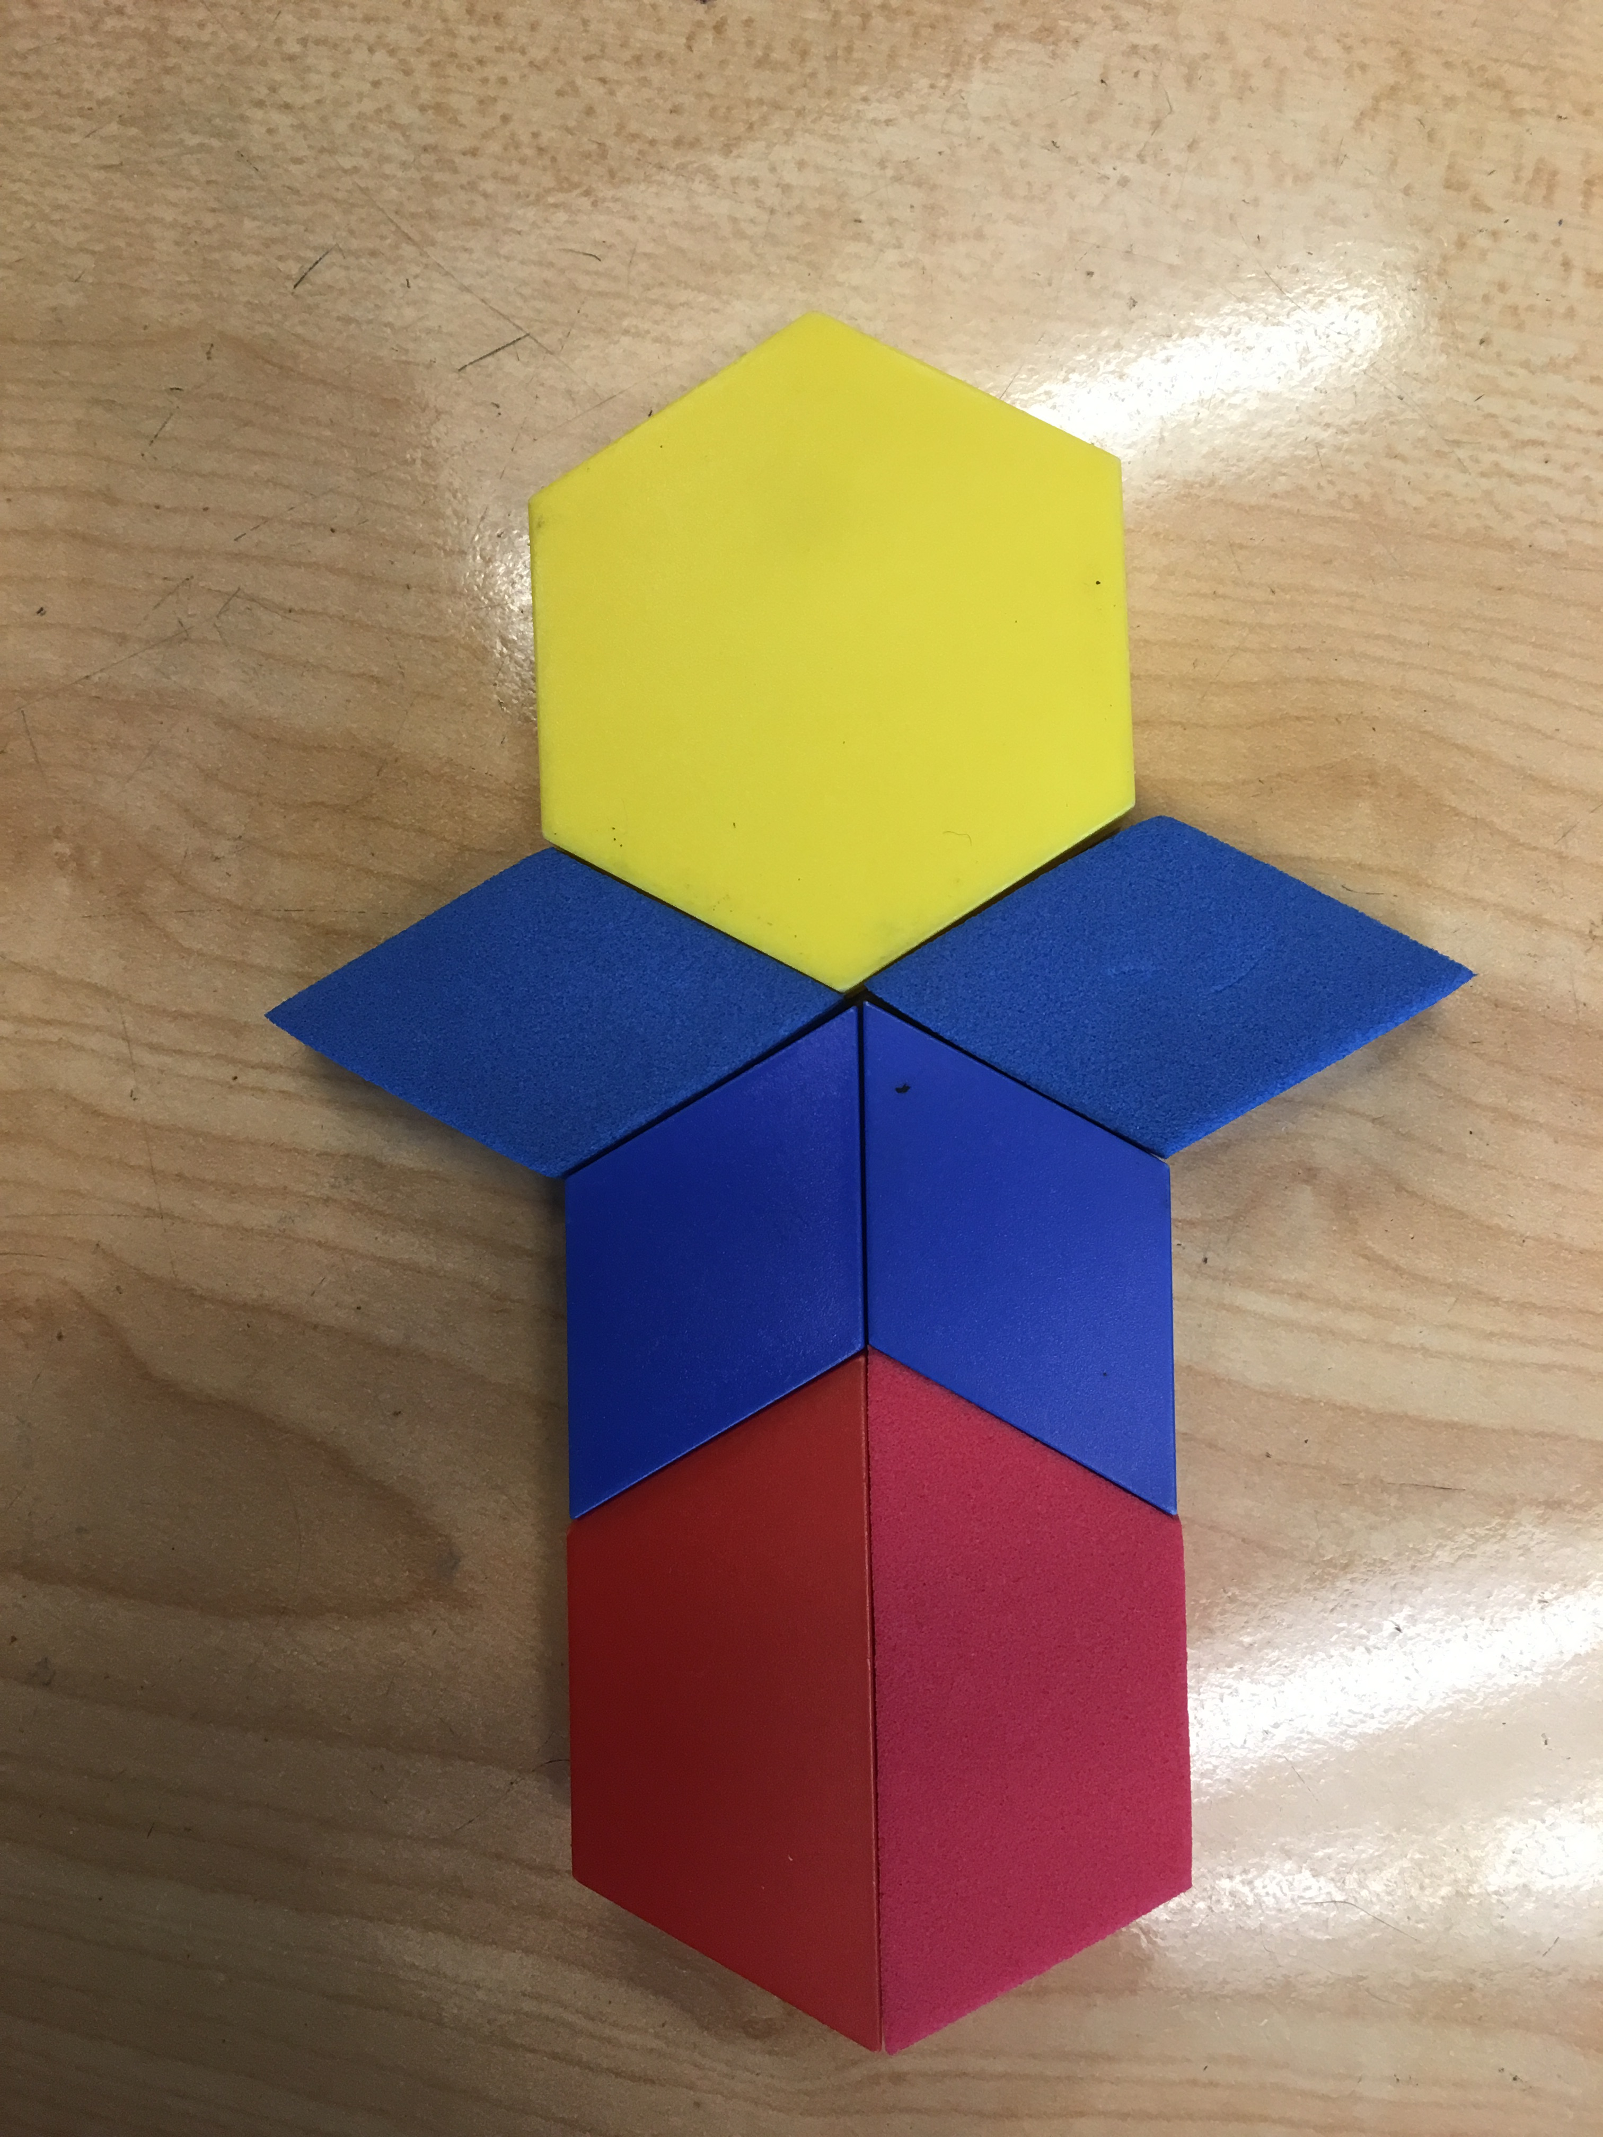

Slide 26
Build it!

Slide 28
Build it!

Slide 29
Can you build the same figure suing different shapes?
How many different ways can you build it?

Slide 30
You will need:
6 triangles 4 skinny rhombuses

Slide 31
Ready…Set…Look!

Slide 32
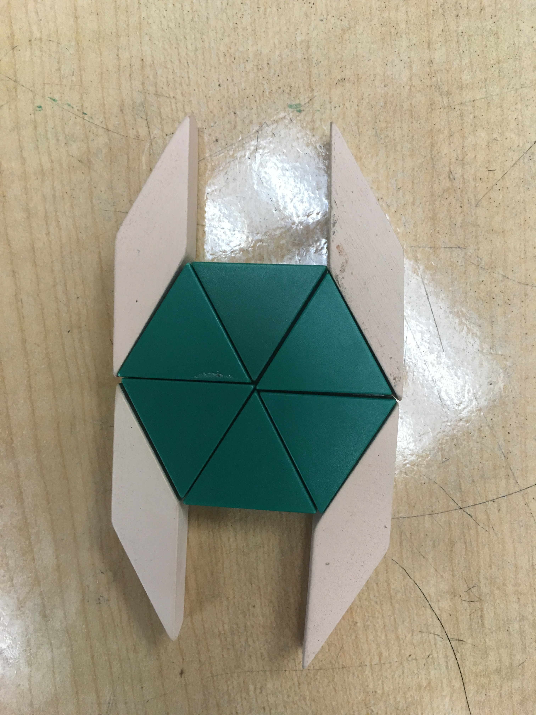

Slide 33
Build it!

Slide 35
Build it!

Slide 36
Can you build this figure with different shapes?
How many different ways can you build it?

Slide 37
You will need:
1 hexagon 1 trapezoid 4 rhombuses
1 triangle 2 skinny rhombuses

Slide 38
Ready…Set…Look!

Slide 39
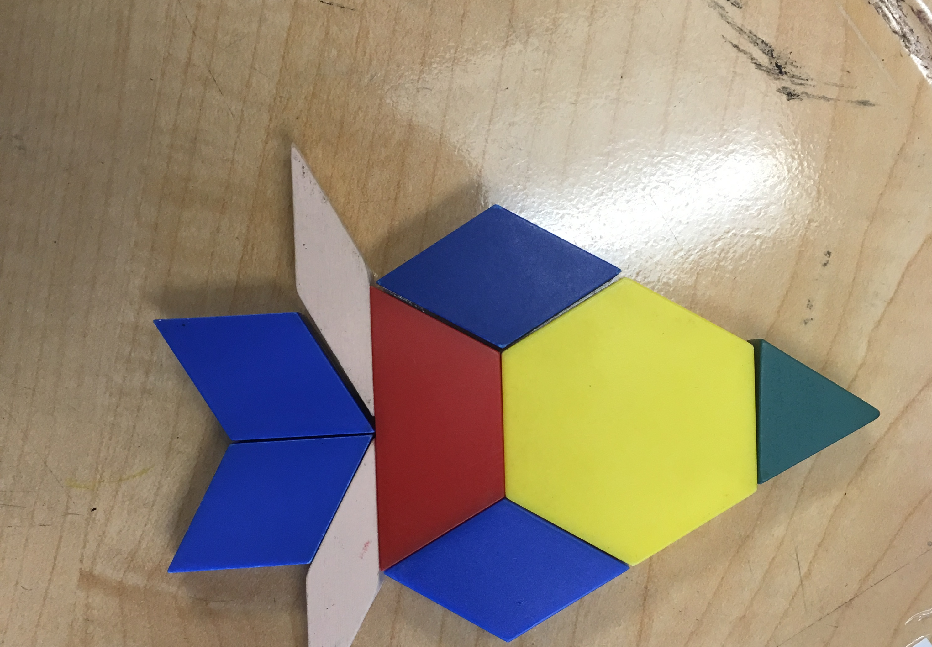

Slide 40
Build it!

Slide 42
Build it!

Slide 43
Can you build this figure with different shapes?
How many different ways can you build it?

Slide 44
You will need:
2 hexagons 2 trapezoids 2 rhombuses
2 triangles 1 square

Slide 45
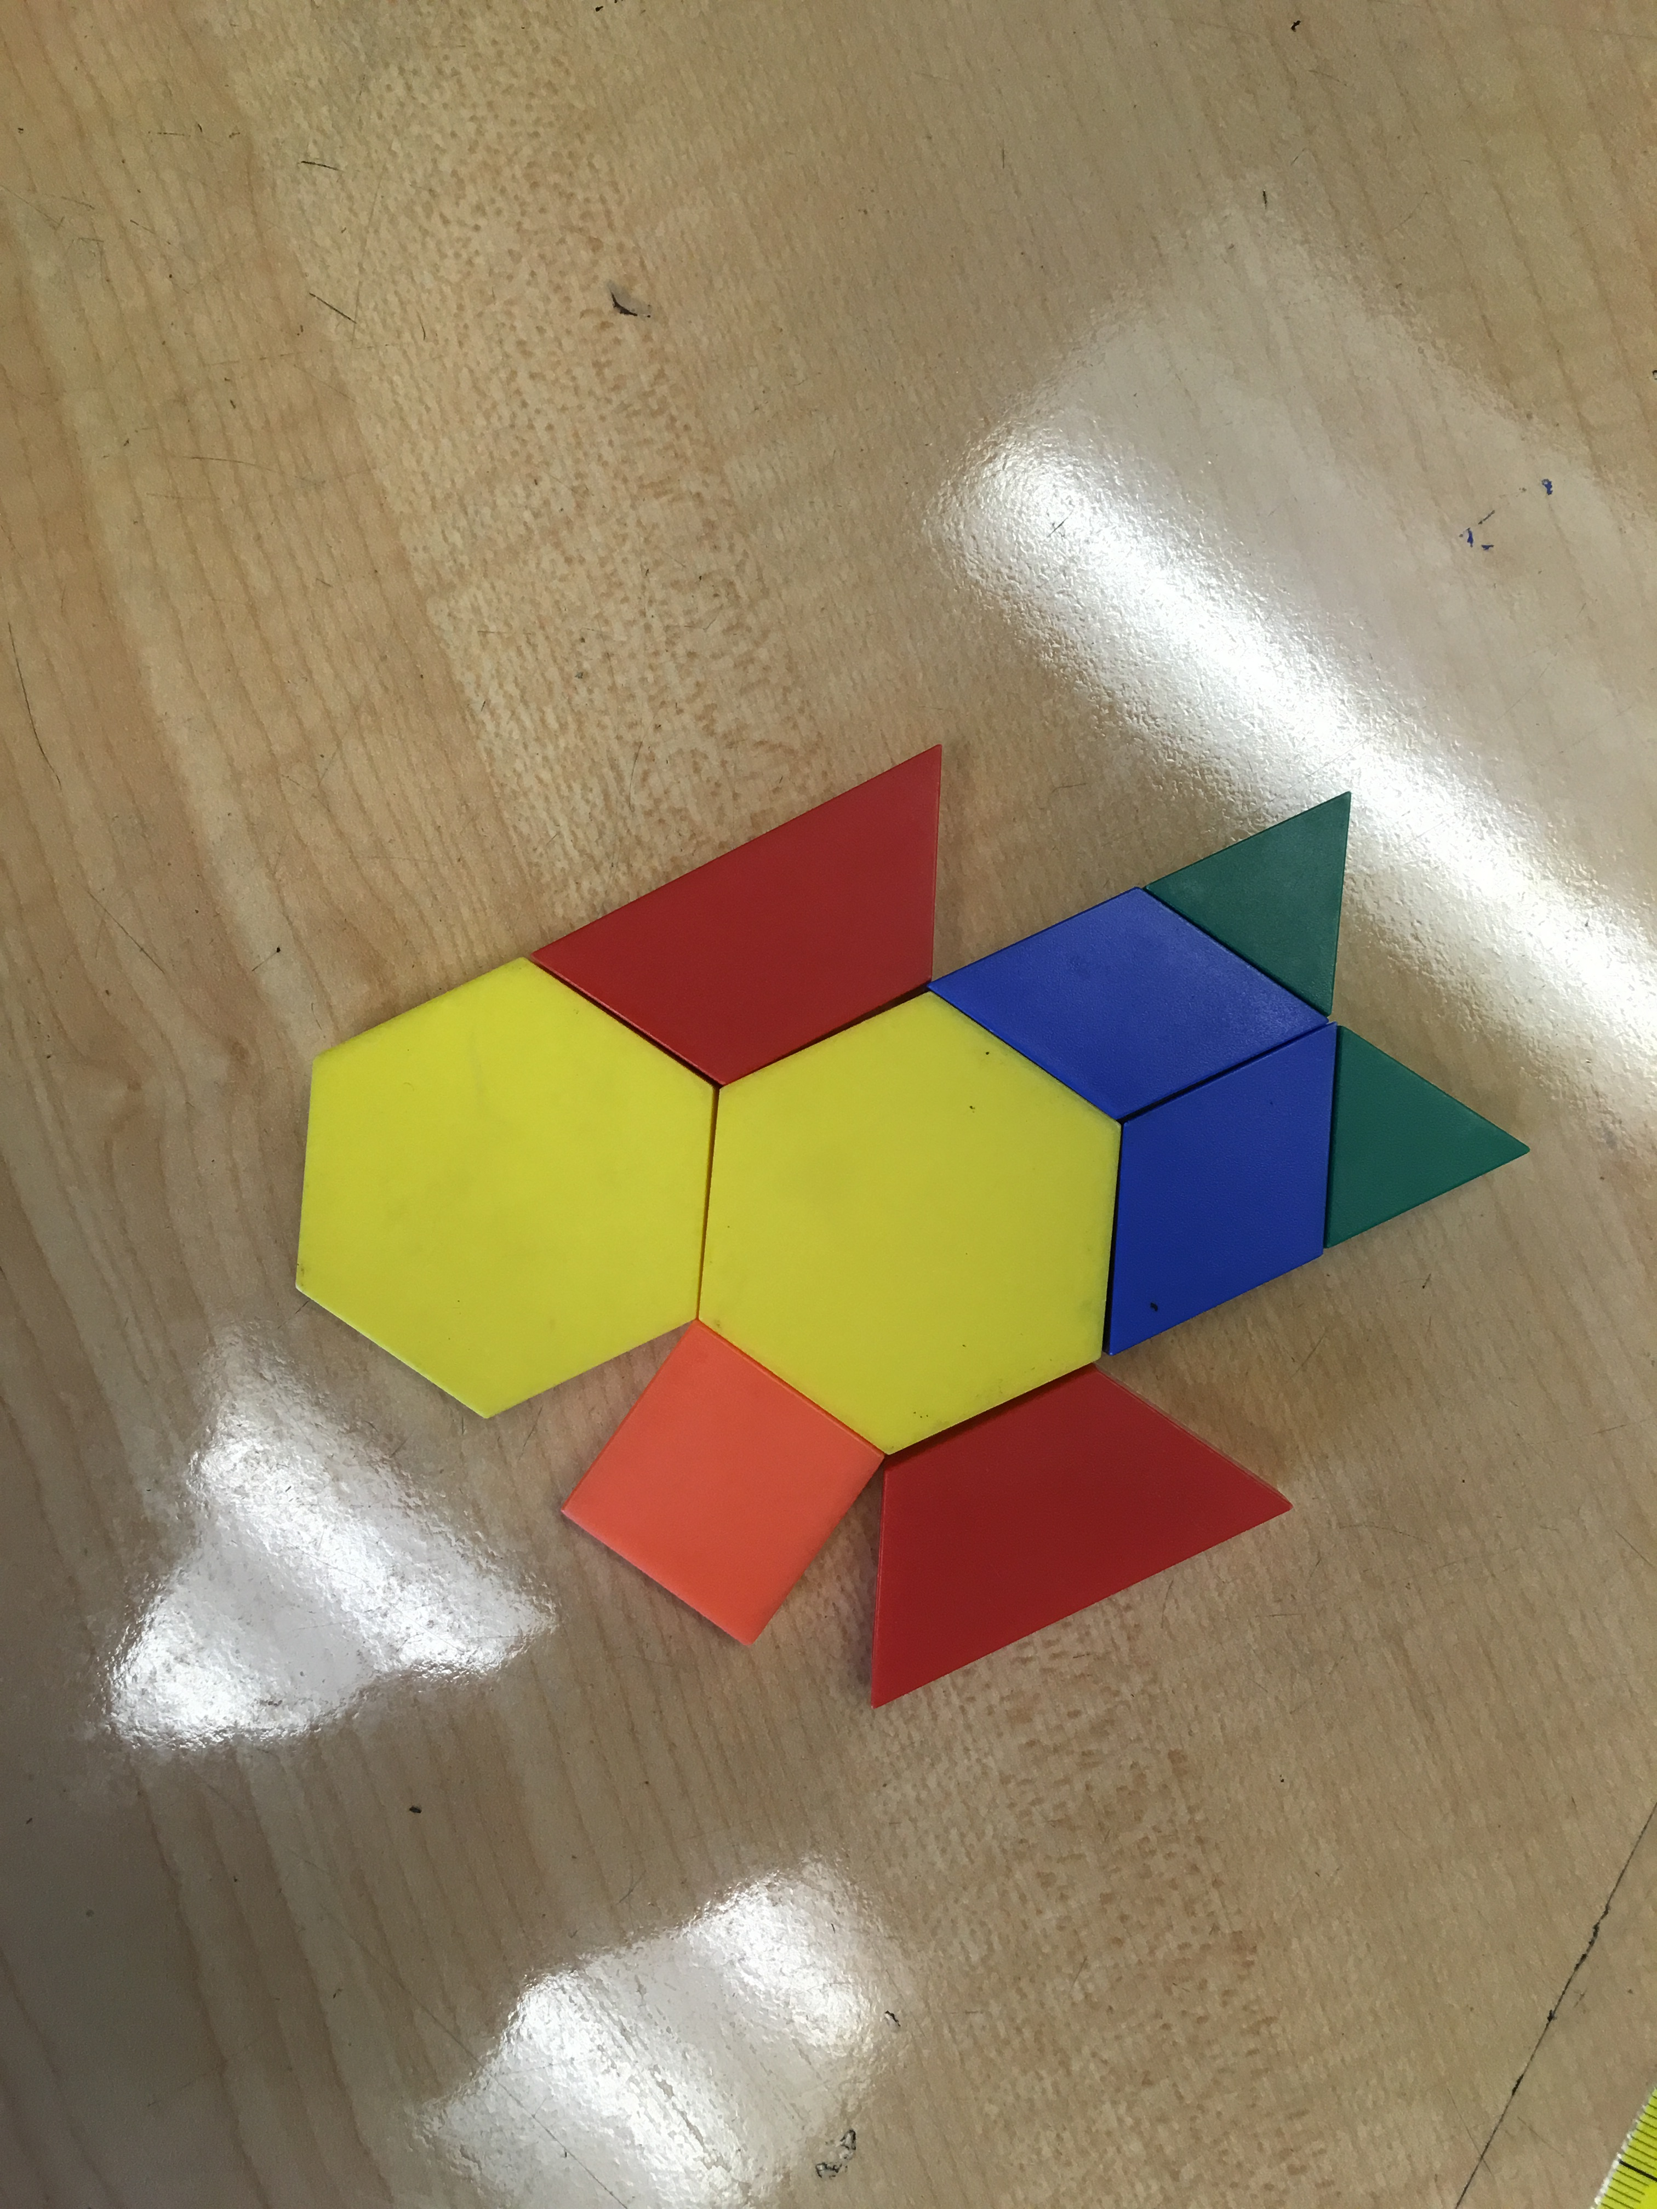

Slide 46
You will need:
0 hexagons 1 trapezoid 3 rhombuses
6 triangles 0 skinny rhombuses 0 squares

Slide 47
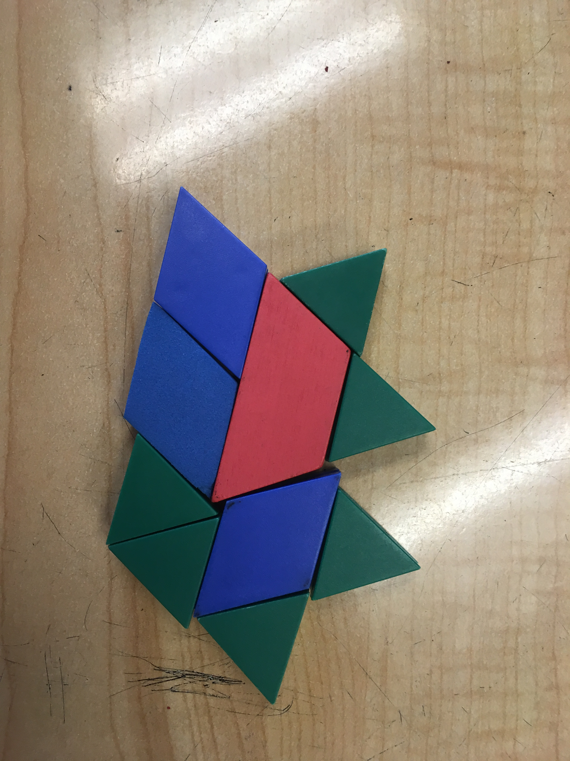

Slide 48
Ready…Set…Look!

Slide 50
Ready…Set…Look!

Slide 52
Ready…Set…Look!

Slide 53
You will need:
Some hexagons Some trapezoids Some rhombuses
Triangles skinny rhombuses squares

Slide 54
Ready…Set…Look!

