Slide 1
Cuisenaire Rods
Mostly everything you wanted to know...

Slide 2
Concrete Pictorial Symbolic:
Front Matter of the Alberta Program of Studies K-12

Slide 3
Where are we at...
Beginning
Emerging
Progressing
Advancing
Mastering
I am new to using manipulatives and representations and want to learn more.
I’ve experimented with manipulatives and representations in my classroom for a few concepts..
I use manipulatives and representations in my practice regularly but want to deepen my understanding.
I am confident using manipulatives and representations in my classroom.
I use manipulatives and representations confidently in my practice and help others.

Slide 4
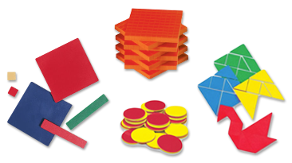
Develop conceptual understanding
Visualization
Flexibility with multiple representations
Why?
Make sense of algorithms and procedures
Immediate feedback
Communication
Connect mathematical ideas
Inclusion
Notes:
Cited in Van de Walle et. al, 2018).

Slide 5
Cuisenaire Rods

Slide 6
Nrich.maths.org
https://nrich.maths.org/public/search.php?search=cuisenaire+rods=
=Lots of great ideas for rich, inquiry problems to explore.

Slide 7
What do you notice?
What do you wonder?

Slide 8
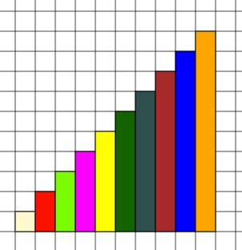
Compose and Decompose Numbers
Choose a number from 10 to 20.
How many different ways can you make that number using the cuisenaire rods?
What are the factors of 12?
Compose and Decompose Numbers

Slide 9
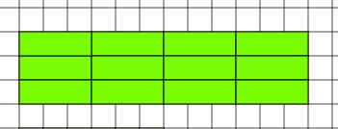
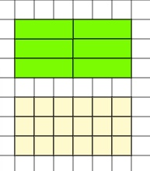
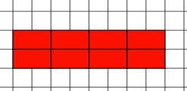
Arrays--Use the rods to model 3 X 6
Write equations for this picture:
Multiplication and Division

Slide 10
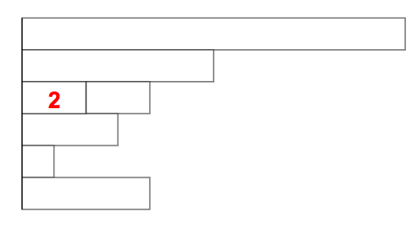
If this is TWO, what is the value of the other rods?
Relationship between numbers

Slide 11
Reasoning, Problem Solving and Inquiry
Notes:
https://nrich.maths.org/13

Slide 12
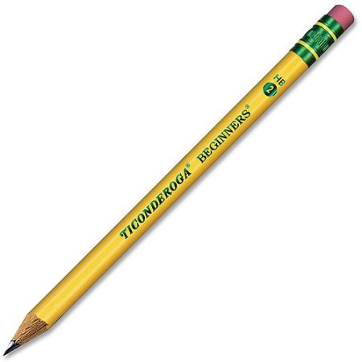
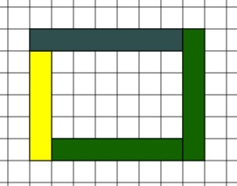
The WHITE rod is a 1 X 1 square. How might it be used to figure out and develop an understanding of AREA?
Using the rods, find the length of your pencil.
?
What is the perimeter of this figure?
How many red rods equal the weight of two orange rods?
Measurement

Slide 13
What fraction of the orange rod is the yellow rod?
Using as many brown and red rods as you like, but no rods of any other colours, work out what fraction the red rod is of the brown one.
Make a model of
⅔,
½,
¾,
⅚
Pick two other rods of different colours. Given an unlimited supply of rods of each colour, work out what fraction the shorter rod is of the longer one.
Given an unlimited supply of any two differently coloured rods, can you find a general rule to work out what fraction the shorter rod is of the longer one?
Why does your rule work?
Fractions

Slide 14
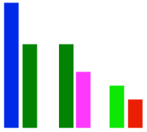
What is the ratio of the pair below?
Here are three pairs of rods. The ratio of all the pairs is 3 : 2.
Using only single rods what pair can you find with the same ratio as the pair below?
Ratio

Slide 15
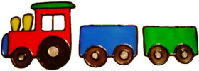
How do you play?
You'll need a grown-up to play with.
You'll also need one Cuisenaire rod of each length between 1 (white) and 10 (orange), or you can just write down the numbers on a piece of paper.
Decide who is going to go first, and choose a distance between 11 and 55. We'll use 25 as an example. The aim of the game is to make a train of length 25 (exactly).
Each player in turn puts down a Cuisenaire rod, putting them end to end so that there is a single train. The person who puts down the last rod to make 25 wins. If one player puts down a rod that makes the train longer than 25, then the other player wins. (If you aren't using rods, then you can use each of the numbers between 1 and 10, but only once.)
Does it make a difference who goes first?
Can you work out a winning strategy?
Train for Two--Logical Thinking

